Slide 1
Software Testing
Test Processes
Presented By
Ning Chen, Ph.D.
Professor
Department of Computer
Science
California State University,
Fullerton
© Ning Chen, 2018
*

Slide 2
Module Objectives
This module focuses on understanding test processes

Slide 3
Motivation
Logical question:
  Is knowing all the test techniques enough in achieving high quality software?
  Our answer is no.

Slide 4
Avoiding the Oops Moment
In the old good days when software is not that big and complicate the development could be effectively done with a handful of hotshot developers. A tester probably could apply the techniques from what he/she learned in the previous chapters without bothering his colleagues (fellow developers/tests) too much. Some occasional informal chats on issues would be enough.

Slide 5
How to avoid?
Same as a pilot, you, as an Agile software tester, do not want to have an “Oops” moment!
A logical way to avoid an “Oops” moment is to have some process on hand to follow. Those 8 processes suggested in ISO/IEC/IEEE 29119 in some sense are very heavy and at the first glance, may not be suitable entirely for an Agile Development. Nevertheless, we believe, it is worthwhile to take a look before we jump to any conclusion.

Slide 6
Organizational Test Process
If one reads ISO/IEC/IEEE 29119 on the organizational test process, one may find the following useful statements:
The Organizational Test Process is used to develop and manage organizational test specifications. These specifications typically apply to testing across the whole organization (i.e. they are not project-based).
Organizational Test Policy and Organizational Test Strategy are examples of organizational test specifications.

Slide 7
Do you buy it?
We think most readers will not have any problem to comprehend the above statements and most, if not all, probably will agree those common sense based statements too. Nevertheless, the key questions will be on what the process is made of and what the outcomes of the process are.

Slide 8
Process steps (activities)
Since a process is a number of steps (e.g., activities and tasks) performed, ISO/IEC/IEEE 29119 specifies the following activities:

Slide 9
Activities of Organizational Test Process
Develop Organizational Test Specification (OT1)
Monitor and Control Use of Organizational Test Specification (OT2)
Update Organizational Test Specification (OT3)

Slide 10
What are the tasks?
Sure enough under each activity there are many more recommended tasks that make of the named activity. We don’t think it is a good idea to even look at the tasks recommended for an activity at this point for two reasons. First, we want to practice the technique of abstraction here – seeing all the detailed information all at once may not help at all. Second, all the activities are self-explanatory. We probably can guess what the tasks are without reading the standard further.
At this point we hope that readers, although may not 100% comprehend the organizational test process, feel ease on it.

Slide 11
Outcomes
a) The requirements for organizational test specifications are identified;
b) The organizational test specifications are developed;
c) The organizational test specifications are agreed to by stakeholder(s);
d) The organizational test specifications are made accessible;
e) Conformance to the organizational test specifications is monitored;
f) Updates to organizational test specifications are agreed to by stakeholder(s); and
g) Updates to the organizational test specifications are made.

Slide 12
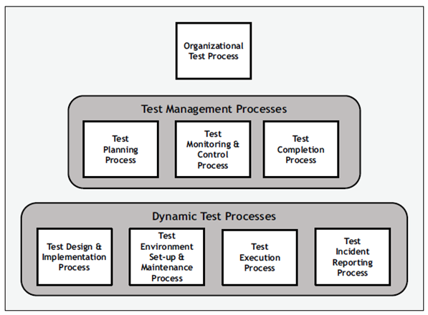
The second layer –
Test Management Processes

Slide 13
Test Management Processes
There are three test management processes:
  Test planning process
  Test monitoring and control process
  Test completion process

Slide 14
Can you buy it?
As mentioned before Test Management Processes deal with the management aspects. From the management point of view, to have a plan, to monitor and control the execution of the plan, and to see the completion of the plan is simply a natural way of managing. We don’t think it is hard to accept those three processes.

Slide 15
Next question?
The logical questions we ask are still what those processes are made off (i.e., activities and tasks) and their outcomes.

Slide 16
Activities of Test Planning Process
Understand Context (TP1)
Organize Test Plan Development (TP2)
Identify and Analyze Risks (TP3)
Identify Risk Mitigation Approaches (TP4)
Design Test Strategy (TP5)
Determine Staffing and Scheduling (TP6)
Record Test Plan (TP7)
Gain Consensus on Test Plan (TP8)
Communicate Test Plan and Make Available (TP9)

Slide 17
Outcomes of the Test Planning Process
a) The scope of work of the test project is analyzed and understood;
b) The stakeholders who will participate in the test planning are identified and informed;
c) Risks that can be treated by testing are identified, analyzed and classified with an agreed level of risk exposure;
d) Test strategy, test environment, test tool and test data needs are identified;
e) Staffing and training needs are identified;
f) Each activity is scheduled;
g) Estimates are calculated and evidence to justify the estimates is recorded

Slide 18
Test Monitoring and Control Process
Activities:
  Set-Up (TMC1)
  Monitor (TMC2)
  Control (TMC3)
  Report (TMC4)

Slide 19
Outcomes of Test Monitoring and Control Process
a) The means of collecting suitable measures to monitor test progress and changing risk are set up;
b) Progress against the test plan is monitored;
c) New and changed test-related risks are identified, analyzed and necessary action(s) invoked;
d) Necessary control actions are identified;
e) Necessary control actions are communicated to the relevant stakeholders;
f) The decision to stop testing is approved;
g) Test progress and changes to the risks are reported to stakeholders.

Slide 20
Test Completion Process
Activities of Test Completion Process
  Archive Test Assets (TC1)
  Clean Up Test Environment (TC2)
  Identify Lessons Learned (TC3)

Slide 21
Outcomes of Test Completion Process
a) Test assets are either archived or passed directly to the relevant stakeholders;
b) The test environment is in its agreed state (e.g. so that it is available for the next test project);
c) All test requirements are satisfied and verified; d) The Test Completion Report is recorded

Slide 22

The Third Layer – Dynamic Test Processes

Slide 23
Dynamic Test Processes
There are four dynamic test processes:
a) test design & implementation;
b) test environment set-up & maintenance;
c) test execution; and
d) test incident reporting.

Slide 24
Test Design & Implementation Process
Activities of Test Design & Implementation Process
  Identify Feature Sets (TD1)
  Derive Test Conditions (TD2)
  Derive Test Coverage Items (TD3)
  Derive Test Cases (TD4)
  Assemble Test Sets (TD5)
  Derive Test Procedures (TD6)

Slide 25
Test Design & Implementation Process
Outcomes of Test Design & Implementation Process
  a) The test basis for each test item is analyzed;
  b) The features to be tested are combined into Feature Sets;
  c) The Test Conditions are derived;
  d) The Test Coverage Items are derived; e) Test Cases are derived; f) Test Sets are assembled;
  g) Test Procedures are derived.

Slide 26
Test Environment Set-Up & Maintenance Process
Activities of Test Environment Set-Up & Maintenance Process
  Establish Test Environment (ES1)
  Maintain Test Environment (ES2)

Slide 27
Test Environment Set-Up & Maintenance Process
Outcomes of Test Environment Set-Up & Maintenance Process
  a) The test environment is set-up in a state ready for testing;
  b) The status of the test environment is communicated to all relevant stakeholders;
  c) The test environment is maintained.

Slide 28
Test Execution Process
Activities of Test Execution Process
  Execute Test Procedure(s) (TE1)
  Compare Test Results (TE2)
  Record Test Execution (TE3)

Slide 29
Test Execution Process
Activities of Test Execution Process
  Execute Test Procedure(s) (TE1)
  Compare Test Results (TE2)
  Record Test Execution (TE3)

Slide 30
Test Execution Process
Outcomes of Test Execution Process
  a) The test procedure(s) is/are executed;
  b) The actual results are recorded;
  c) The actual and expected results are compared; and
  d) The test results are determined.

Slide 31
Test Incident Reporting Process
Activities of Test Incident Reporting Process
  Analyze Test Result(s) (IR1)
  Create/Update Incident Report (IR2)

Slide 32
Test Incident Reporting Process
Outcomes of Test Incident Reporting Process
  a) Test results are analyzed;
  b) New incidents are confirmed;
  c) New incident report details are created;
  d) The status and details of previously-raised incidents are determined;
  e) Previously-raised incident report details are updated as appropriate;
  f) New and/or updated incident reports are communicated to the relevant stakeholders.

